Slide 1


So You’ve got the Cloud 2:
Cloud-to-Ground
Boogaloo

Slide 2
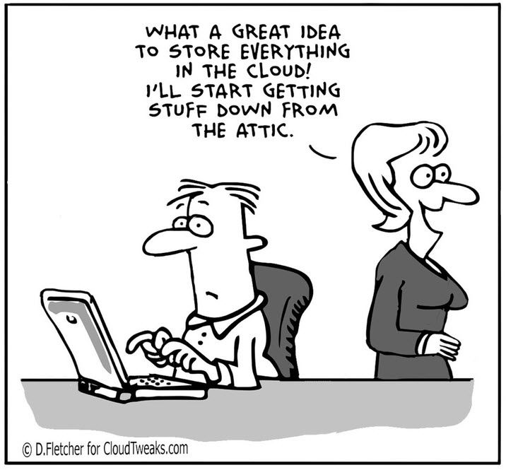
Objectifs / Objectives
Part 1 (April 2021)
ESDC Cloud Environment overview (Revisit)
Cloud Intake
Now What?
Azure DevOps
Part 2 (May 2021)
What is SCED?
Do I need SCED?
How do I request SCED?

Slide 3

What is SCED?
SCED stands for Secure Cloud Enablement and Defence
Also referred to SC2G – Secure Cloud to Ground
Provides a secure connection between our Azure Cloud and SSC as well as secure internet connectivity for IaaS-based cloud resources
Made up of two distinct parts: CAP and TIP
CAP is used to manage internet bound traffic
TIP is used to manage traffic bound for on-prem
Considerations when implementing SCED:
SCED connections aren’t managed by ESDC’s cloud team. They’re managed by SSC
BRDs are required to implement SCED connectivity
SCED currently has a single point of failure for connecting to our cloud – Identified as a HIGH RISK in SA&A
Sandbox workspaces cannot connect through SCED

Slide 4
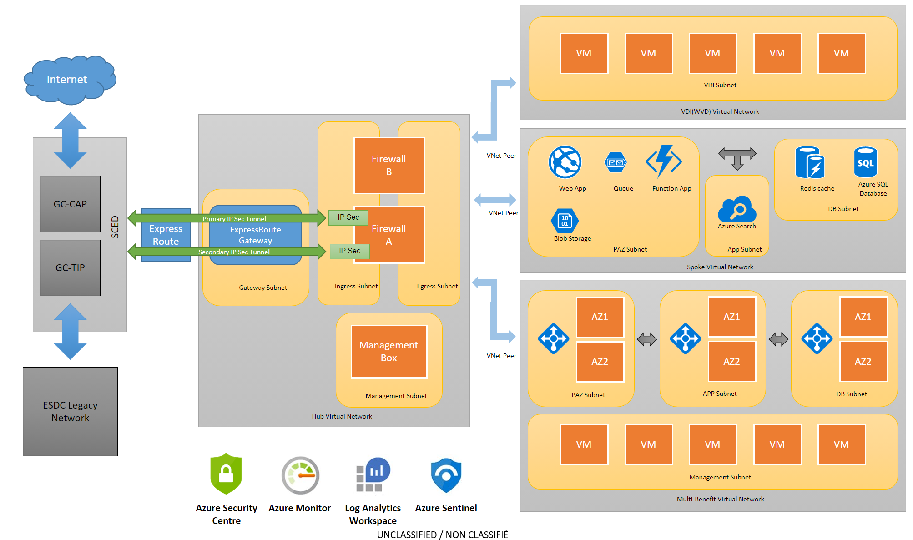
Basic SCED Network Diagram for ESDC

Slide 5
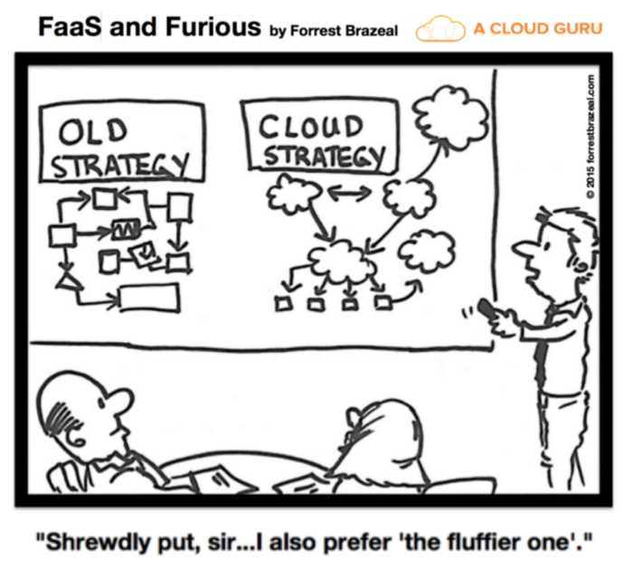
Do I actually need SCED?
I need SCED if:
I require connectivity back to a legacy service or database that can’t/won’t be moved to the cloud
I am using IaaS or any other infrastructure requiring a private IP that needs to connect to the internet
I do not need SCED for:
Security logging and monitoring of cloud resources
DNS Service for cloud based applications (both internet and intranet facing apps)
Cloud based access to Active Directory (AAD)
PaaS services (such as App Services) that do not leverage private IP addresses do not require SCED to reach the internet
If you aren’t sure if you need SCED, ask.

Slide 6

How do I request a SCED connection?
SCED is a service that is provided to our cloud by Shared Services Canada.
There are two separate forms/documents that need to be filled out to request SCED Connectivity. These are a BRD (Business Requirements Document) and a WIF (Workload Implementation Form)
The BRD is responsible for documenting the business requirements for your workload request.
Keep in mind that BRDs are prioritized by SSC based on workload importance
Requests need to be linked to projects or pre-existing workloads.
Requests for “just in case” connectivity will not be prioritized
Communication with SSC regarding BRDs is done through our SPM (Service Portfolio Management) group. They will help guide you through the paperwork process of SSC and should be able to provide you with updates on how your request is going.

Slide 7

How do I request a SCED connection?
The WIF documents the actual work required to implement this solution. SPM can provide the forms necessary.
SCED WIFs document traffic flows going to and from our cloud to both on-prem and to the internet
This includes internal IP addresses that you would need to reach, as well as specific ports
While subnet ranges are accepted in WIFs, specific ports and IPs for each service need to be documented. SCED is not an open pipe.
DG approval (email) is required for all connections in the WIF before it can be submitted to SSC
If you require any assistance in filling out your WIF, please contact Cloud Operations.

Slide 8
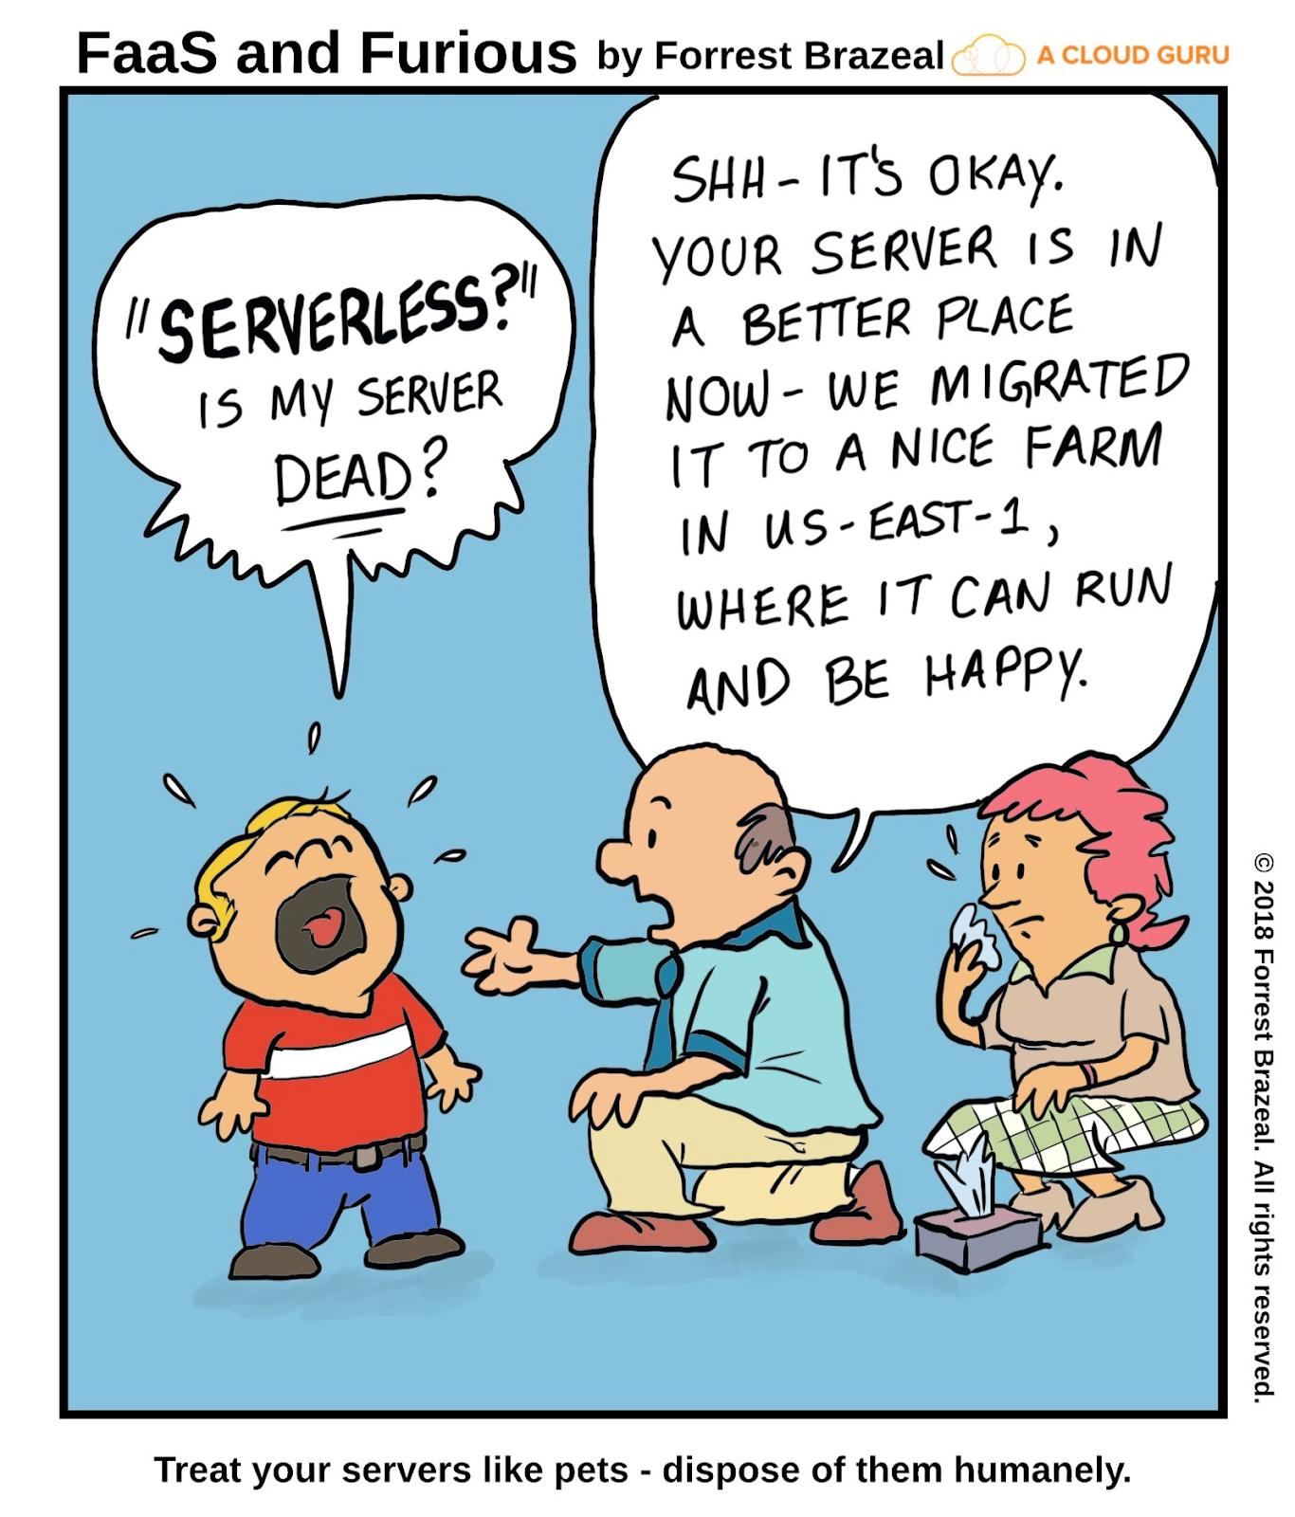
Links/contacts
SCED Connection SharePoint Page: https://014gc.sharepoint.com/sites/OI-CO/SitePages/Spoke-SCED-Connection-Steps.aspx
SPM GD Box: EDSC.DGIIT.GPS-SPM.IITB.ESDC@hrsdc-rhdcc.gc.ca
BRD form: http://service.ssc-spc.gc.ca/sites/default/files/brd_v5_en_final_20190327.xlsm
Cloud Operations GD Box: EDSC.SOUTIEN.DOPS.INFONUAGIQUES-CLOUD.OPS.SUPPORT.ESDC@hrsdc-rhdcc.gc.ca
Cloud Operations SharePoint: https://014gc.sharepoint.com/sites/OI-CO/

Slide 9



Avez-vous des questions ? / Do you have any questions?

